Slide 1
IoT Army of 300
Resource Development to enable Our Brightest Minds in Technology
Abdur Rahman
Lecture 1
Introduction to IoT
Oct 09, 2017

Slide 2
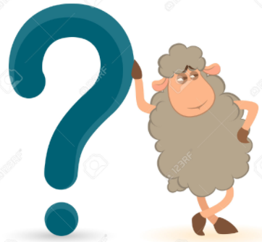
Internet of Things

Slide 3
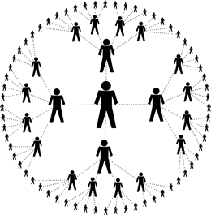

Internet of Things (IoT) ?
Data gathered without any help from us
able to track and count everything
greatly reduce waste, loss and cost
Monitoring condition & store history

Slide 4
Can Plants Talk to humans or other?

Slide 5
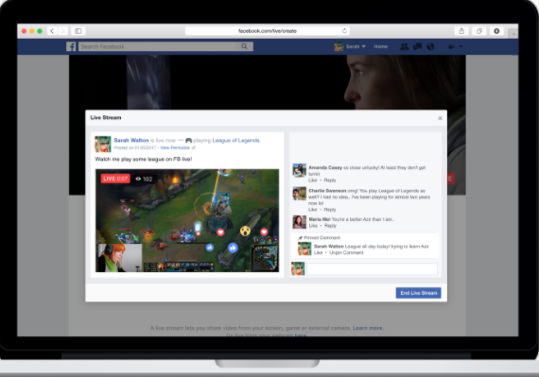

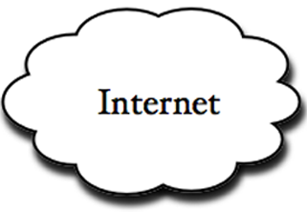
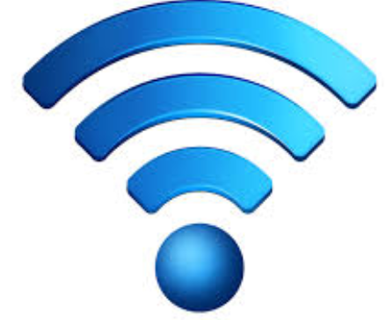
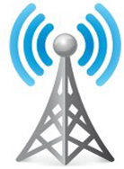
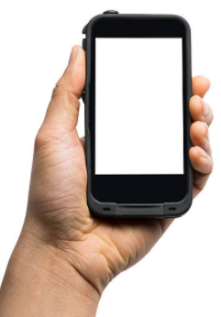
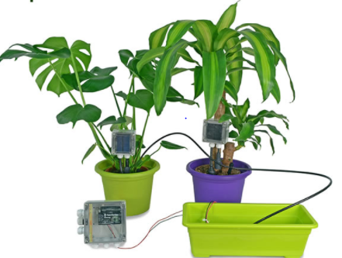
Plant talking??
Hello,
I need
Water!!

Slide 6
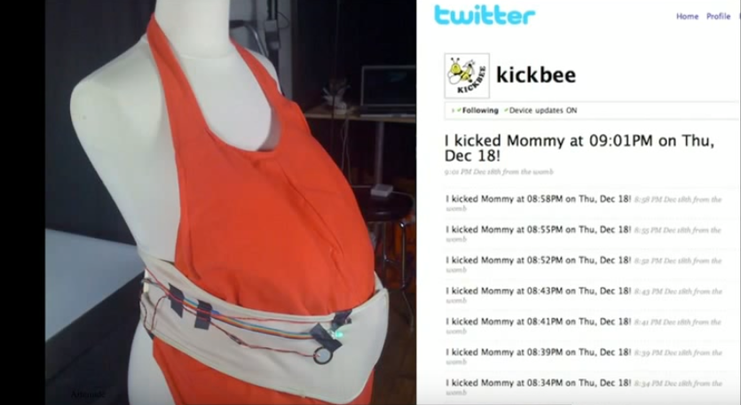
Can communicate and tweet an unborn baby?

Slide 7
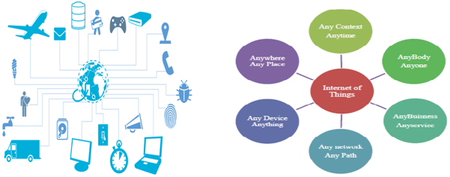
Internet of Things (IoT) ?
So, the Internet of Things is the concept of everyday objects from industrial machines to wearable devices where –
Objects are connected to the Internet.
They communicate each other and control autonomously.
Gather data without human interaction, just using built-in sensors.
Take action on that data across a network.
Internet of Things = “Sensors and actuators embedded in physical objects are linked through wired and wireless networks, often using the same Internet Protocol (IP) that connects the Internet.“

Slide 8
Ultimate goal of IoT
The ultimate goal is to create “a better world for human beings”, where objects around us know what we like, what we want, and what we need and act accordingly without explicit instructions.

Slide 9
Various Names, One Concept
M2M (Machine to Machine)
“Internet of Everything” (Cisco Systems)
“World Size Web” (Bruce Schneier)
“Skynet” (Terminator movie)

Slide 10
Where is IoT?
It’s everywhere!

Slide 11
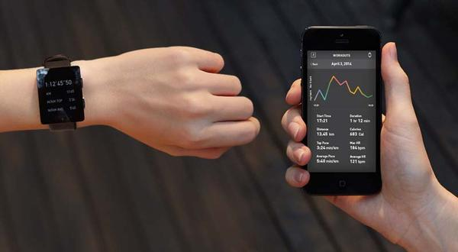
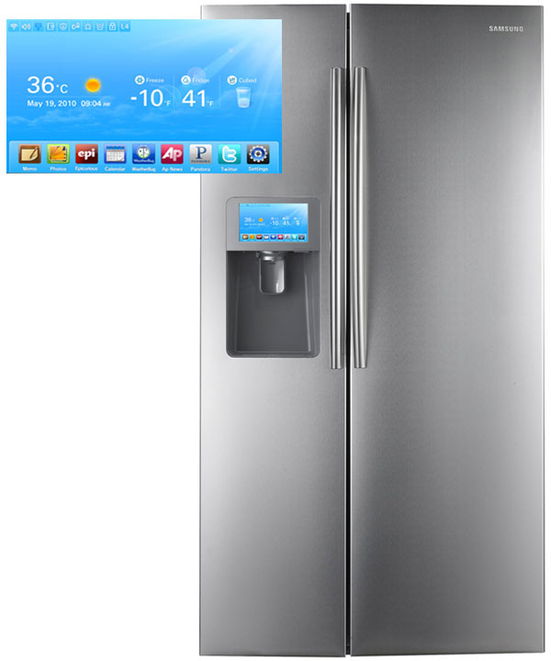
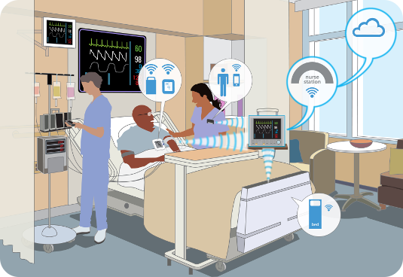

Slide 12
Where is IoT?
Environmental Monitoring
Manufacturing Applications
Energy Applications
Healthcare Applications
Building/Housing Applications
Transportation Applications

Slide 13
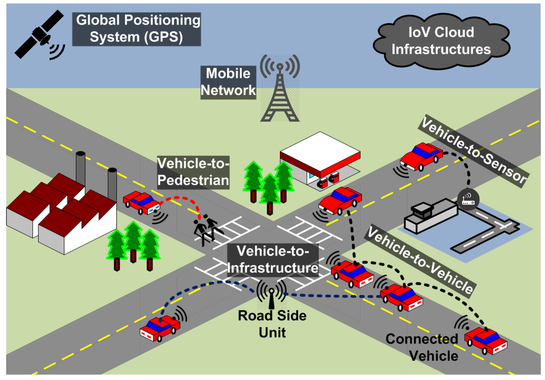
IoT in Transportation System

Slide 14
Value of IoT
IoT is making our life more simple, easy and comfortable.
50 billion connected devices by 2020
More than 6 connected devices per Person
$1.7 trillion in value added to the global economy in 2020
By 2020 IoT will be more than double the size of the smartphone, PC, tablet, connected car, and the wearable market combined.
Technologies and services generated global revenues will reach $8.9 trillion by 2020, growing at a compound annual rate (CAGR) of 7.9%.
5 billion people will have Internet access.

Slide 15
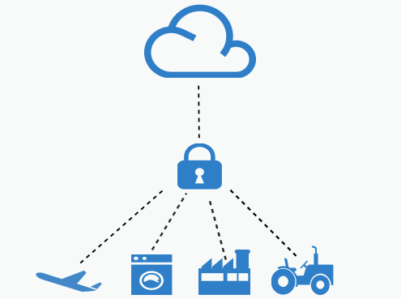
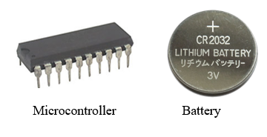
Biggest challenges of IoT??
IoT applications collect more and more previously unexposed -often private – data, and allow access to various control functions over the internet..
More connected devices mean more attack vectors and more possibilities for hackers to target us;
IoT devices have limited computing power, memory and battery life where existing powerful encryption algorithm (RSA, AES, DES) does not support.
So the privacy & security of data & devices are the biggest challenge.

Slide 16
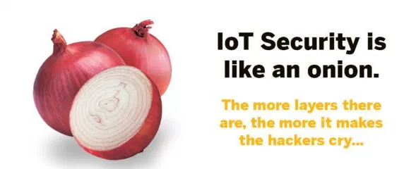

Slide 17
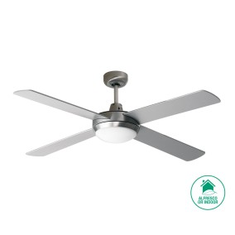
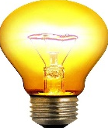
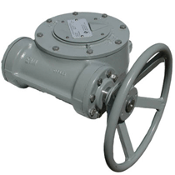
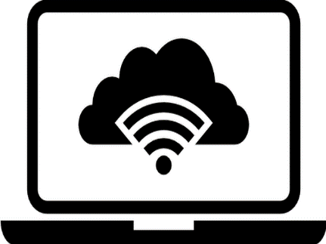
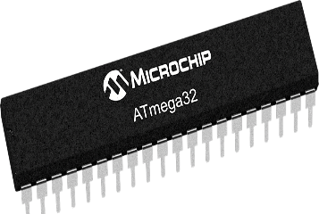




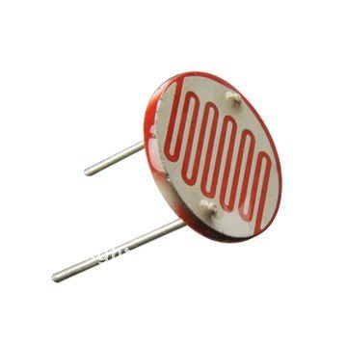
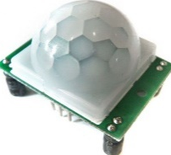

Embedded System
IoT System Architecture
A
Actuator/object
Microl
Microcontroller
GPRS/LAN/WIFI
Web Client
Server
& Database
Sensor

Slide 18
Embedded System
IoT System Architecture
A
Actuator/object
Microl
Microcontroller
GPRS/LAN/WIFI
Web Client
Server
& Database
Sensor

Slide 19
Embedded System
IoT System Architecture
(Device Side)
A
Actuator/object
Microl
Microcontroller
GPRS/LAN/WIFI
Sensor

Slide 20
Thanks

